Slide 1


*Ready-to-use presentation
Too Much to Lose Prescription Drug Misuse
and Illicit and Prohibited Drug Use Campaign
*Date:
Last Updated: October 2023

Slide 2
*Presentation guide
The following ready-to-use presentation slides offer a high-level overview of the Too Much to Lose campaign. This presentation is specifically designed for professionals to present to a professional audience, such as military treatment facility staff, Drug Demand Reduction personnel, Drug and Alcohol Program Advisors (DAPAs), and others who have interest in learning about the campaign and its resources.
Throughout this deck you’ll find highlighted sections for users to personalize and add relevant local information. Be sure to also update the cover page title and *footers for your use.
If you are presenting and would like a more in-depth background of all information and resources related to Too Much to Lose, it may be helpful to review the following materials beforehand:
  Too Much to Lose Campaign Toolkit
  Too Much to Lose Campaign Overview Video
Looking for additional information or have questions? Please email the team: dha.ncr.comm.mbx.prevent-substance-misuse@health.mil
Remove this slide for use

Slide 3
Table of Contents
Too much to lose overview
03
Campaign resources
10
“The views expressed in this presentation are those of the author and do not necessarily reflect the official policy or position of the Department of Defense, nor the U.S. Government.”
Notes:
Today we will be going through some information about the DoD’s Too Much to Lose campaign and its available resources.
DISCLAIMER: The views expressed in this presentation are my own and do not necessarily reflect that of the DoD or the government.

Slide 4
Too much to lose overview www.toomuchtolose.org

Slide 5
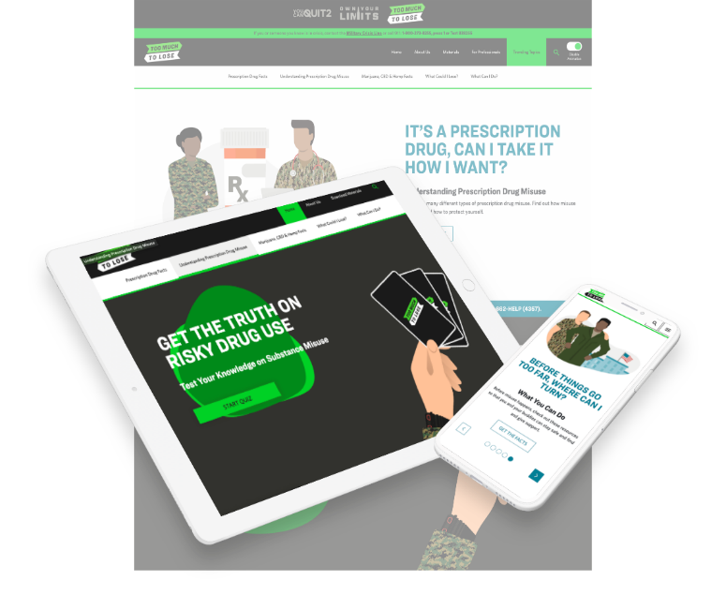
About Too Much to lose
Too Much to Lose is a DoD education campaign, aligned to the Defense Health Agency, developed to address prescription drug misuse and illicit and prohibited drug use including marijuana, CBD and hemp
DoD launched this campaign in September 2020
Notes:
Some background on Too Much to Lose here. Too Much to Lose is the DoD’s campaign that addresses prescription drug misuse and illicit and prohibited drug use including marijuana, CBD, and hemp. It launched in September 2020. There was no prior DoD campaign that addressed risky drug use. The campaign’s goals are to:
Inform Service members on the facts and risks related to prescription drug misuse and illicit and prohibited drug use including marijuana, CBD, and hemp that can impact their health, career, and overall well-being
Provide Service members information and tools so they can be informed about prescription drugs and substances that may be commonly found in their communities, but illegal or prohibited for them to use
Provide friends and loved ones with the information they need to support a Service member who may be struggling with risky drug use
Support professionals such as health educators and those providing alcohol and drug prevention efforts at military commands worldwide, in their mission to educate Service members about prescription drug misuse and illicit and prohibited drug use

Slide 6

Why is Risky drug use important to address?
Risky drug use threatens military readiness and discipline, and the mental and physical resilience of Service members
Service members face unique challenges including deployment, combat, time away from family, and increased stress—all of which may lead them to turn to risky drug use to cope
Risky drug use may result in:
  Reduced ability to learn information, react quickly, and make decisions ¹
  Decreased order and security
  Unplanned loss of personnel
  Increased risk of injury for self and others ¹
Notes:
So why is risky drug use important to address? We know that risky drug use threatens military readiness, discipline, and resilience. Service members are exposed to unique challenges such as deployment, combat, time away from family, and generally increased stress that may cause them to turn to risky drug use to cope. Risky drug use can lead to a lower ability to learn information, react quickly, and make decisions, an overall decrease in order and security, unplanned loss of personnel, and an increase of risk of injury for self and others.

Slide 7
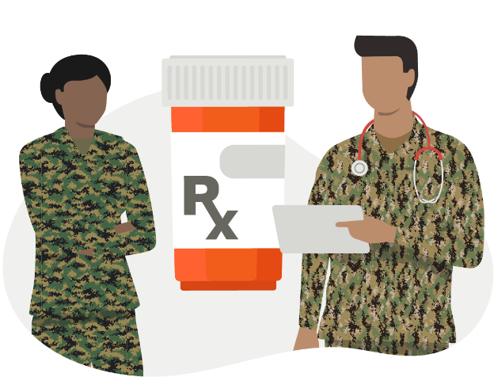
Prescription drug misuse
What is misuse?
  Using prescription drugs without following a health care provider’s directions (such as taking more at a time or more frequently than prescribed), taking someone else’s prescription drug, or using medication for any reason other than why it was prescribed
Commonly misused prescription drugs:
  Opioids
  ADHD medication
  Weight loss medication
  Stimulants
  Depressants
  Common reasons for misuse
  Managing pain
  Maintaining readiness
  Coping with life
Notes:
When Too Much to Lose mentions “prescription drug misuse,” it means using drugs without following a health care provider’s directions such as taking more at a time or more often than prescribed, taking someone else’s prescription drug, or using medication for any reason other than why it was prescribed.
In the military space, we know that the most commonly misused prescription drugs include opioids, ADHD medications, prescription weight loss medications (to meet military standards), stimulants, and depressants. The most common reasons a Service member may misuse prescription drugs are to manage pain, maintain readiness like staying awake to stand watch or falling asleep, and to cope with life.

Slide 8
know the difference:
Marijuana, cbd, And hemp ²
Marijuana: Cannabis plants with more than 0.3% Delta-9 THC (by dry weight)
  Produces a high
  Can sometimes create psychological or physical dependence
  Can be smoked, vaped and eaten
Cannabidiol (CBD): A chemical compound in hemp and marijuana
  Should not produce a high
  Products are not regulated and could have some amounts of THC
Hemp: Cannabis plants with less than 0.3% Delta-9 THC (by dry weight)
  Should not produce a high (like CBD) but THC levels are not regulated
  Used to produced materials and foods
Tetrahydrocannabinol (THC): A chemical compound in hemp and marijuana
  In high enough quantities, produces the “high” related to marijuana
  Found in edibles, weed or pot, and vape oils
  Notable products include Delta-8 THC and Delta-9 THC
Notes:
Knowing the difference between marijuana, CBD, and hemp is a crucial part of Too Much to Lose. When the campaign mentions marijuana, it means cannabis plants with more than 0.3% Delta-9 THC by dry weight. Marijuana produces a high, can sometimes create psychological or physical dependence, and can be smoked, vaped and eaten. Cannabidiol, also known as CBD, is a chemical compound in hemp and marijuana. It should not produce a high, but CBD products are not regulated and could have some amounts of THC in them. When the campaign mentions hemp, it means cannabis plants with less than 0.3% Delta-9 THC by dry weight. Hemp should not produce a high but THC levels are not regulated. Hemp is used to produce materials like rope, clothing, lotions and shampoos, and food products. Tetrahydrocannabinol, also known as THC, is the chemical compound in hemp and marijuana which, in high enough quantities, produces a high. THC is found in edibles, weed or pot, and vape oils. Notable products of hemp include Delta-8 THC and Delta-9 THC.

Slide 9
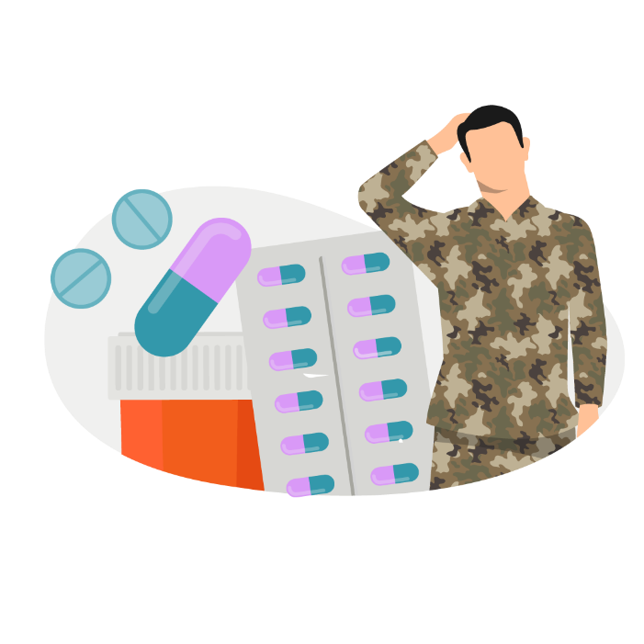
WHAT is the DoD Drug policy? ^{3,4}
The DoD prohibits the use, possession, and distribution of marijuana in any form, including medical use
The DoD prohibits Service members from using products made or derived from hemp, no matter the claimed or actual THC levels, including CBD
  Exceptions: durable hemp goods like rope or clothing
  FDA-approved cannabinoid medications with a valid prescription
Other policies also address prescription drugs to ensure Service members understand misuse
Some Services have zero tolerance polices surrounding substance use
*Footer
Notes:
When discussing risky drug use within the military setting, it’s important to be aware of the DoD drug policy. The DoD prohibits the use, possession, and distribution of marijuana in any form, including for medical use. It prohibits Service members from using products made or derived from hemp, no matter the claimed or actual THC levels, and that includes CBD. The only exceptions to that rule are durable hemp goods like rope or clothing and FDA-approved cannabinoid medications for which a Service member has a valid prescription. Other DoD and Service-level policies also address prescription drugs to ensure Service members understand misuse and some Services have zero tolerance policies surrounding substance use.

Slide 10
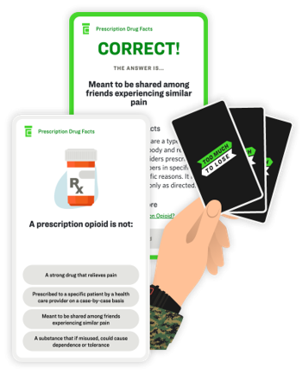
Too much to lose Meets service members where they are
Too Much to Lose supports the DoD’s efforts to build and sustain a ready and resilient force by providing resources and information to Service members so they can use prescription drugs as prescribed and avoid illicit and prohibited substances
The Too Much to Lose campaign is a resource for all Service members regardless of age, rank, Component, or Service branch
Too Much to Lose is established in a .org web space due to topic sensitivity. Service members can access the site on any device 24/7
The campaign is not a TRICARE® program and is not tied to TRICARE benefits – the resources are available to all Service members as well as professionals, family, and friends
Notes:
Too Much to Lose was created to meet Service members where they are. It supports the DoD’s efforts to build and sustain a ready and resilient force by providing resources and information to Service members so they can use prescription drugs as prescribed and avoid illicit and prohibited substances. The campaign is a resource for all Service members regardless of age, rank, Component or Service branch. This is because the risk factors for risky drug use can vary across a Service member’s career. The Too Much to Lose website is established in a .org webspace instead of .mil due to topic sensitivity and anyone can access the site on any device 24/7. The campaign resources are available to all Service members, professionals, family, and friends – it is not a TRICARE program and is not tied to TRICARE benefits.

Slide 11
Campaign Resources

Slide 12
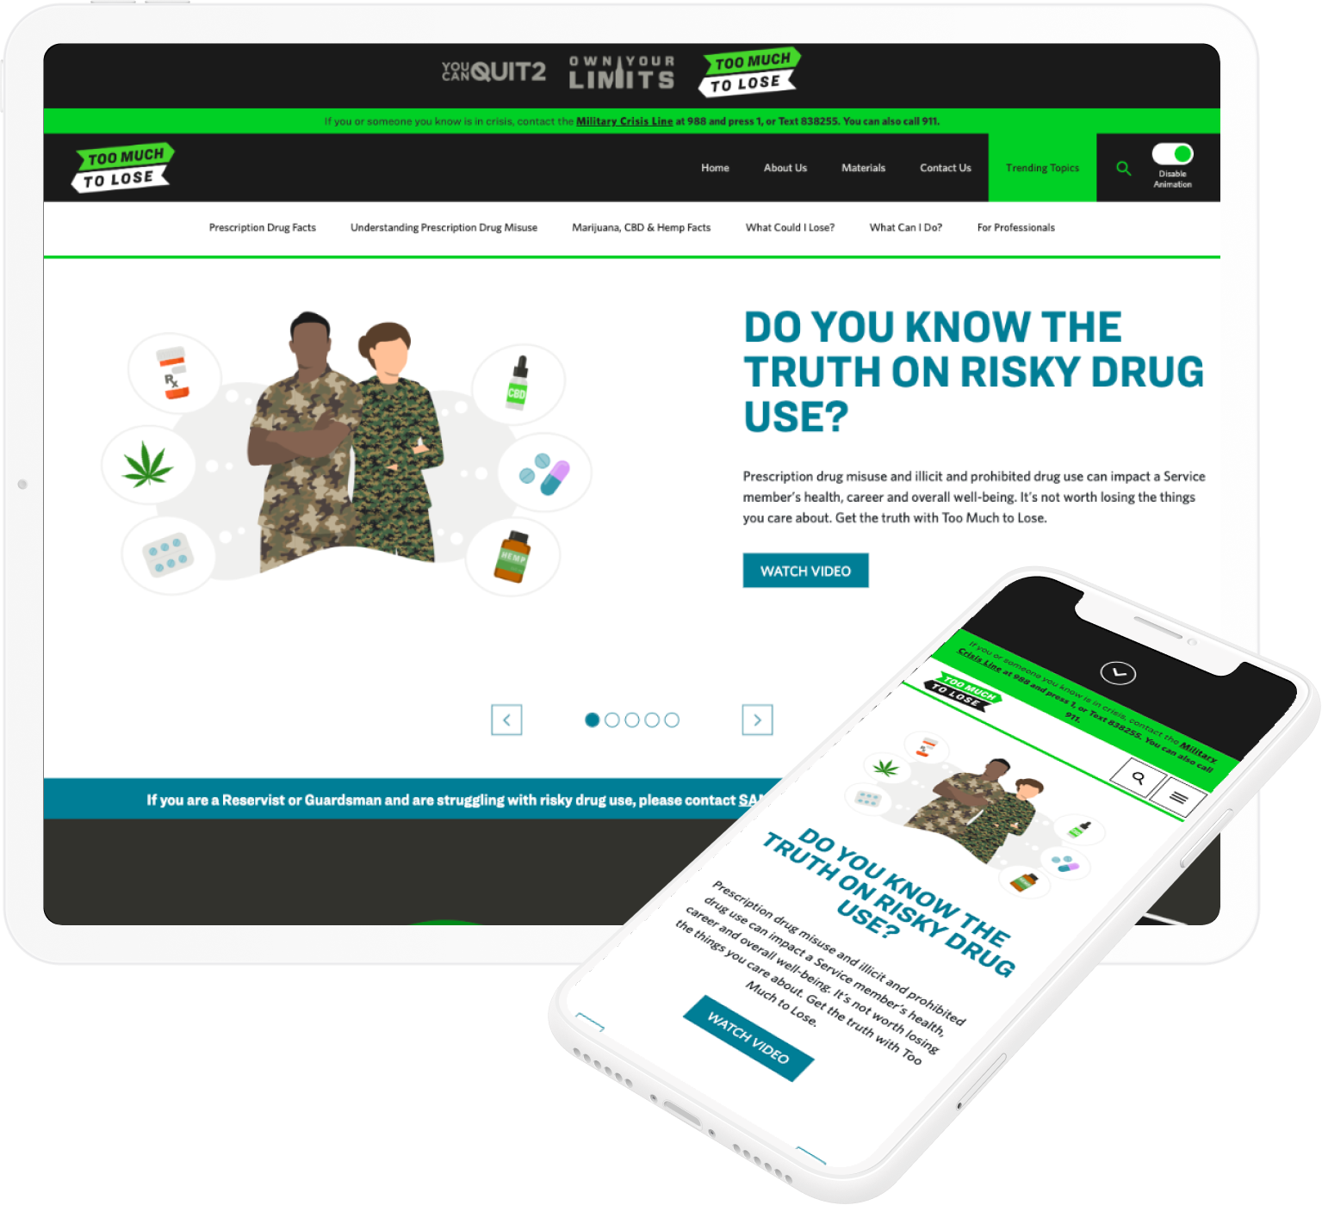
Campaign Website sections
Prescription Drug Facts. Find information about the types of prescription drugs and why each of them may be prescribed
Understanding Prescription Drug Misuse. Find articles on different types of prescription drug misuse. Service members can find out how misuse happens and how to protect themselves
Marijuana, CBD & Hemp Facts. Discover articles with answers to questions on marijuana and other prohibited substances like CBD and hemp
What Could I Lose. Risky drug use can affect career, health and relationships. Find tips on how Service members can protect the things they care about
What Can I Do. Before misuse happens, Service members can check out resources to stay safe and find and give support
Notes:
When you visit the Too Much to Lose website, you’ll find that it’s divided into multiple sections. You can access each section from the homepage. The first section is called “Prescription Drug Facts” where one would find information about the types of prescription drugs and why each of them might be used. In “Understanding Prescription Drug Misuse” one can find articles on different types of prescription drug misuse, how misuse happens, and how Service members can protect themselves. In the “Marijuana, CBD & Hemp Facts” section, there are articles with answers to questions on marijuana, CBD and hemp. The “What Could I Lose” section has tips on how Service members can protect their career, health and relationships. The last section, “What Can I Do” has resources Service members can check out before misuse happens so they can stay safe and find and give support.

Slide 13

Trending Topics
Service members can go to the Trending Topics webpage to find information about new and trending risky drug use topics to help protect themselves and their career. Some of the topics featured include:
  Rainbow fentanyl
  Fentanyl overdoses
  Delta-8 THC
  CBD cigarettes
  Hemp-infused energy drinks
  Latest dangerous opioid: Nitazenes
  New marijuana legalization laws
Notes:
In the top right-hand corner of the Too Much to Lose homepage, you’ll find a big green box that says “Trending Topics.” This regularly updated webpage offers information about new and trending risky drug use topics to help Service members protect themselves and their careers. The Too Much to Lose team stays connected with the Services so they can continuously include topics on the Trending Topics webpage that are current and relevant. Some of the topics featured include rainbow fentanyl, fentanyl overdoses, Delta-8 THC, CBD cigarettes, hemp infused energy drinks, the latest dangerous opioid called Nitazenes, and information about new marijuana legalization laws.

Slide 14
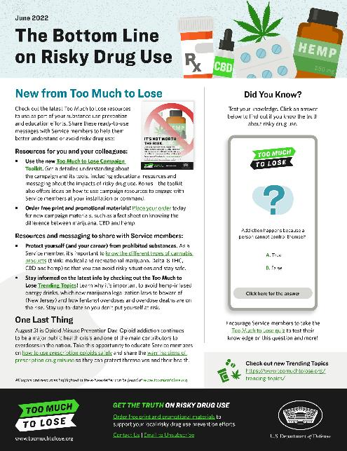
Using Too Much to lose as a professional (1/3)
Check out resources in the For Professionals section of the website
Review the Campaign Toolkit, a one-stop-shop for all things related to the Too Much to Lose campaign
Subscribe to The Bottom Line on Risky Drug Use e-Newsletter
  Visit toomuchtolose.org and click “Contact Us” in the bottom right-hand corner to send the campaign a message. Select “Sign up for our e-Newsletter” as subject
Notes:
There are numerous ways that professionals can use the Too Much to Lose campaign to support their risky drug use prevention efforts. There is actually a dedicated For Professionals section of the Too Much to Lose website where professionals like yourselves can find resources.
In that section, you’ll find the Too Much to Lose Campaign Toolkit, a one-stop-shop for all things related to the campaign. You can subscribe The Bottom Line on Risky Drug Use e-newsletter to get quarterly updates on the campaign and valuable resources sent directly to your inbox.

Slide 15
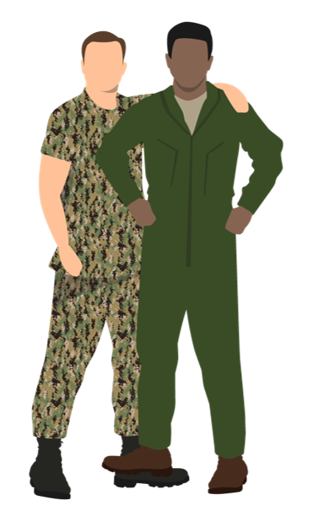
Using Too Much to lose as a professional (2/3)
Order free bulk print and promotional materials
Use ready-to-use social media messaging to supplement your efforts in sharing educational resources with Service members
Add a link to direct website visitors from your organization’s website to Too Much to Lose to help Service members find prescription drug misuse and illicit and prohibited drug use resources
Notes:
Professionals can take advantage of the Too Much to Lose campaign’s free bulk print and promotional materials to get free campaign materials sent directly to you at your installation or command. Professionals can also use the ready-to-use social media messaging available to supplement your efforts in sharing educational resources with Service members. You can also link to the campaign on your website using the available graphics and HTML code.

Slide 16
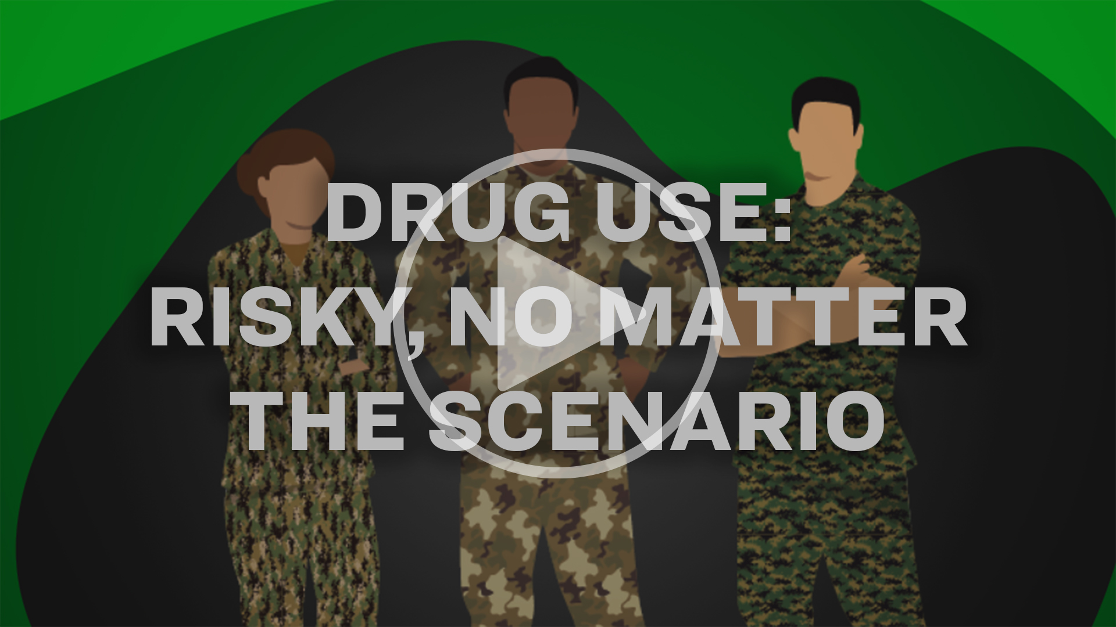
Using Too Much to lose as a professional (3/3)
Stream or download videos including the Campaign Overview Video, and Drug Use: Risky, No Matter the Scenario
Notes:
Professionals can also stream or download any of the Too Much to Lose videos including the Campaign Overview Video which offers an introduction to the campaign, and the campaign’s newest video which we’ll watch here, Drug Use: Risky, No Matter the Scenario (HIT PLAY IF YOUR SYTEM ALLOWS)

Slide 17
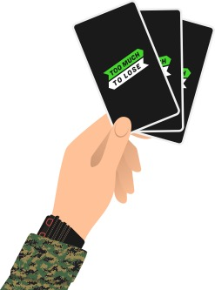
Resources for service members
The Get the Truth on Risky Drug Use Knowledge Quiz allows Service members to take an interactive quiz on the campaign website homepage to understand what they already know about risky drug use.
Notes:
On the Too Much to Lose website’s homepage, if you scroll down to the second horizontal section, you’ll find the Get the Truth on Risky Drug Use Knowledge Quiz. Service members can take this interactive quiz to understand what they may already know about risky drug use. Professionals may share this interactive resource to supplement their existing efforts.

Slide 18
Resources for service members (continued)
Web articles featuring a variety of resources about risky drug use including illicit and prohibited substances, and the impacts of risky drug use on health, career, and well-being. Examples include:
  What’s the Deal with Fentanyl?: Describes the side effects and risks of using prescription fentanyl
  The Risks of Self-Medicating: Explains what self-medicating is and the risks Service members may face if they self-medicate
  Steer Clear from Vaping CBD: Explains the risks that Service members face if they vape CBD and gives examples of ways to decrease stress without using CBD
  Sharing Meds is Riskier Than it Seems: Describes what it means to share prescription medication and the risks of sharing
  Eating Hemp: It’s Not Just Another Plant: Explains the DoD policy on eating hemp or using products made from hemp or that contain components of hemp which is prohibited for Service members
Notes:
Professionals can also utilize and share any of the available web articles on the Too Much to Lose website. Find articles like What’s the Deal with Fentanyl, which describes the side effects and risks of using prescription fentanyl; The Risks of Self-Medicating, which explains what self-medicating is and the risks Service members may face if they self-medicate; Steer Clear from Vaping CBD, which explains the risks that Service members face if they vape CBD and gives examples of ways to decrease stress without using CBD; Sharing Meds is Riskier Than it Seems, which describes what it means to share prescription medication and the risks of sharing; or Eating Hemp: It’s Not Just Another Plant, which explains the DoD policy on eating hemp or using products made from hemp or that contain components of hemp which is prohibited for Service members.

Slide 19
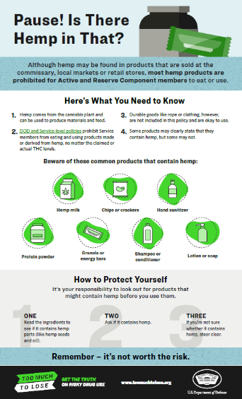
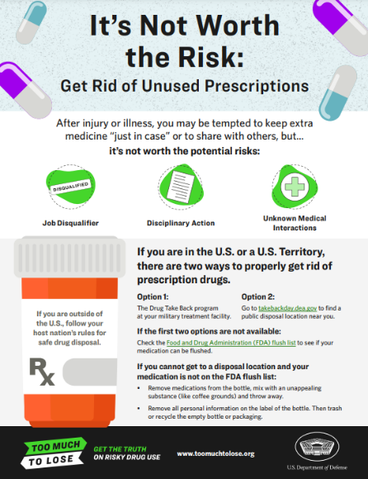
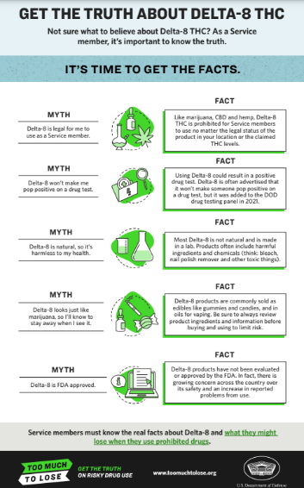
Downloadable resources
Too Much to Lose has downloadable resources that offer helpful information about the impacts of risky drug use such as:
Infographic Link
Poster Link
Infographic Link
Notes:
Professionals can also view/print/disseminate any of the Too Much to Lose downloadable resources (posters, infographics, and fact sheets), many of which are also available on the free bulk ordering I mentioned earlier. These three materials here are examples of the many pieces available.

Slide 20

Local Information
**Use this slide to add relevant local contact information for programs and POCs such as Drug Demand Reduction, Alcohol and Drug Abuse Prevention Treatment (ADAPT), DAPAs, etc., news, and updates below:
News
Updates
**Remove for use

Slide 21

Contact The Too Much to Lose Team
Let the team know how you’re using the campaigns to work with Service members at your installations! Please reach out with any questions or content needs.
Email: dha.ncr.comm.mbx.prevent-substance-misuse@health.mil
Notes:
The Too Much to Lose team wouldn’t be successful without the feedback and collaboration they have with the Services and professionals. They want to hear from you to understand how you may be using the campaigns to work with Service members. Please reach out to them with any questions, requests for information, or new ideas for specific resources.

Slide 22
References
1 https://addiction.surgeongeneral.gov/sites/default/files/surgeon-generals-report.pdf
2 https://toomuchtolose-media.s3.amazonaws.com/TMTL_infographic-know-the-difference.pdf
3 https://toomuchtolose-media.s3.amazonaws.com/TMTL_DOD-memorandum_prohibition-of-marijuana-use.pdf
4 https://toomuchtolose-media.s3.amazonaws.com/TMTL_DOD-memorandum_adoption-of-punitive-general-orders-to-address-use-of-hemp-products.pdf

Slide 23

Closing slide
Visit us
www.toomuchtolose.org
Check out our other campaigns
www.ownyourlimits.org
www.ycq2.org

